Slide 1




ParkiSense
Parkinson’s Early Detection
Applications of Machine Learning

Slide 2
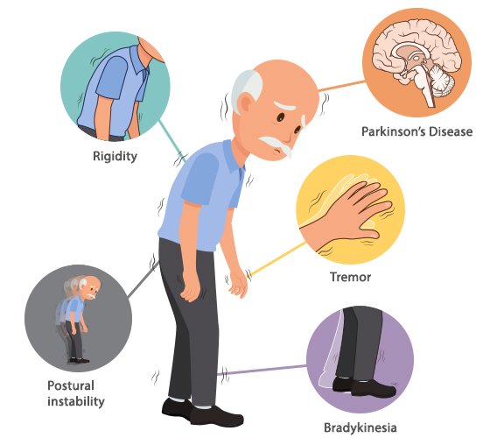
What is Parkinsons ?

Slide 3
Problem Statement
What is Parkinson’s Disease?
A progressive nervous system disorder that affects movement.
Symptoms include tremors, stiffness, and difficulty with balance and coordination.
Why is Early Detection Important?
Early diagnosis can help manage symptoms and improve the patient’s quality of life.
Traditional diagnosis methods rely on clinical assessments, which can be subjective.

Slide 4
Problem Statement
Our Goal:
Develop a comprehensive platform for keystroke analysis and voice analysis to aid in the early detection of Parkinson’s Disease.
Utilize Stochastic Gradient Descent (SGD) classifier for keystroke-based analysis.
Apply CatBoost for voice-based classification to enhance prediction accuracy.
Build an interactive chatbot to assist users by answering queries related to Parkinson’s Disease and providing insights based on test results.

Slide 5

Dataset Overview
Dataset Used: Tappy Data & Parkinson’s Dataset
Tappy Data Source:- https://physionet.org/content/tappy/1.0.0/
Parkinsons Data Source:-
https://archive.ics.uci.edu/dataset/174/parkinsons
Key Features:
Jitter & Shimmer: Measures of frequency and amplitude variation.
Noise-to-Harmonics Ratio (NHR): Represents the proportion of noise in the signal.
Motor Function Data from Tappy: Analyzing typing patterns.

Slide 6
Tech Stack
Keystroke Analysis:
Algorithm: Stochastic Gradient Descent (SGD)
Libraries: Scikit-learn, Pandas, NumPy
Processing: Feature extraction from typing patterns
Voice Analysis:
Algorithm: CatBoost
Libraries: CatBoost, Librosa, Pandas, NumPy
Processing: Feature extraction from audio recordings
Chatbot for Queries:
API: Google API Key for chatbot integration
Platform & Deployment:
Frontend: Gradio (for user-friendly interaction)

Slide 7
Solution Offered
Machine Learning-Based Early Detection:
Implemented a Stochastic Gradient Descent (SGD) Classifier for efficient and scalable detection of Parkinson’s Disease.
Utilized Tappy data and voice-based features to enhance detection accuracy.
Feature Engineering & Preprocessing:
Identified key biomarkers such as Jitter, Shimmer, and NHR for better classification.
Applied scaling and normalization techniques to handle data variations.
Addressed data imbalance using resampling techniques to improve model performance.

Slide 8
Solution Offered
Lightweight and Deployable Model:
Developed a streamlined model suitable for real-time applications.
Potential integration with mobile or web-based diagnostic tools for easy access.
Interpretability & Explainability:
Conducted feature importance analysis to provide insights into the most critical predictors.
Ensured the model’s decisions are transparent for potential clinical use.

Slide 9


Machine Learning Approach
Steps in Model Development:
Data Preprocessing:
Feature selection & scaling.
Handling imbalances in the dataset.
Model Selection:
Chose Stochastic Gradient Descent (SGD) for classification.
Model Training & Evaluation:
Trained using labeled data.
Evaluated performance using accuracy, precision, recall, and F1-score.

Slide 10
WHY SGD?
Scales well with large datasets and high-dimensional data.
Computationally efficient, as it updates weights incrementally rather than in batches.
Performs well with sparse data and noisy datasets.
Can be used with hinge loss to approximate SVM, making it a good alternative for linear classification.
Adaptive to streaming data, making it suitable for real-time applications.

Slide 11
Model Performance and Results
Key Observations:
The model successfully differentiates between Parkinson’s patients and healthy individuals.
Stochastic Gradient Descent (SGD) helped in efficient and scalable learning from the dataset.
Feature importance analysis revealed that Jitter, Shimmer, and NHR play a significant role in classification.
Challenges faced:
Data imbalance required careful handling to improve predictions.
Feature noise impacted learning, requiring preprocessing and feature selection.
Variability in tapping data introduced inconsistencies in predictions.

Slide 12
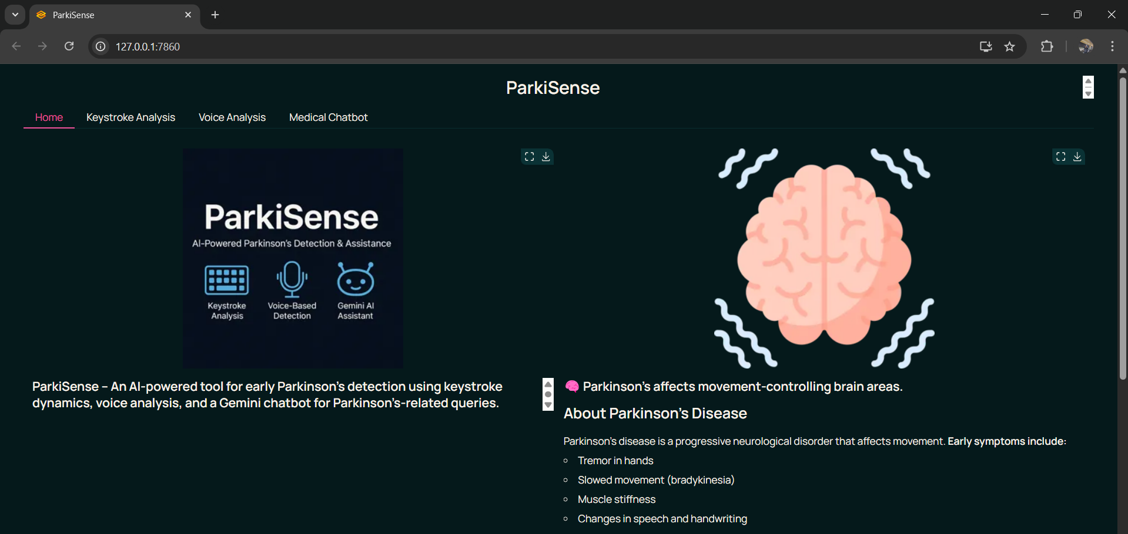
Demo and Application

Slide 13
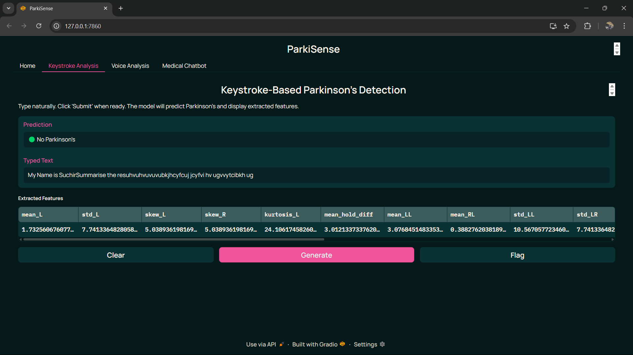
Demo and Application

Slide 14
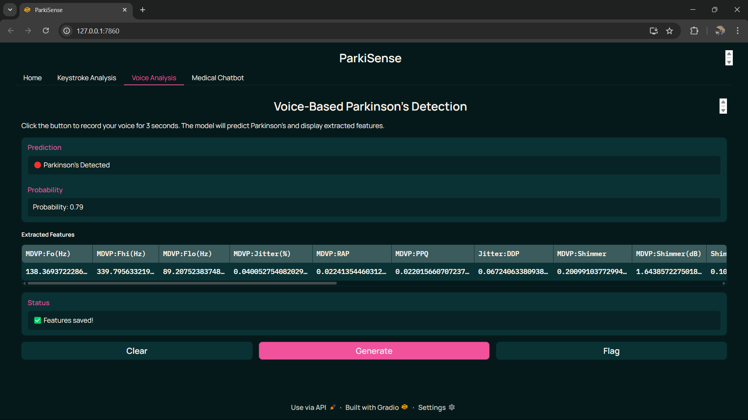
Demo and Application

Slide 15
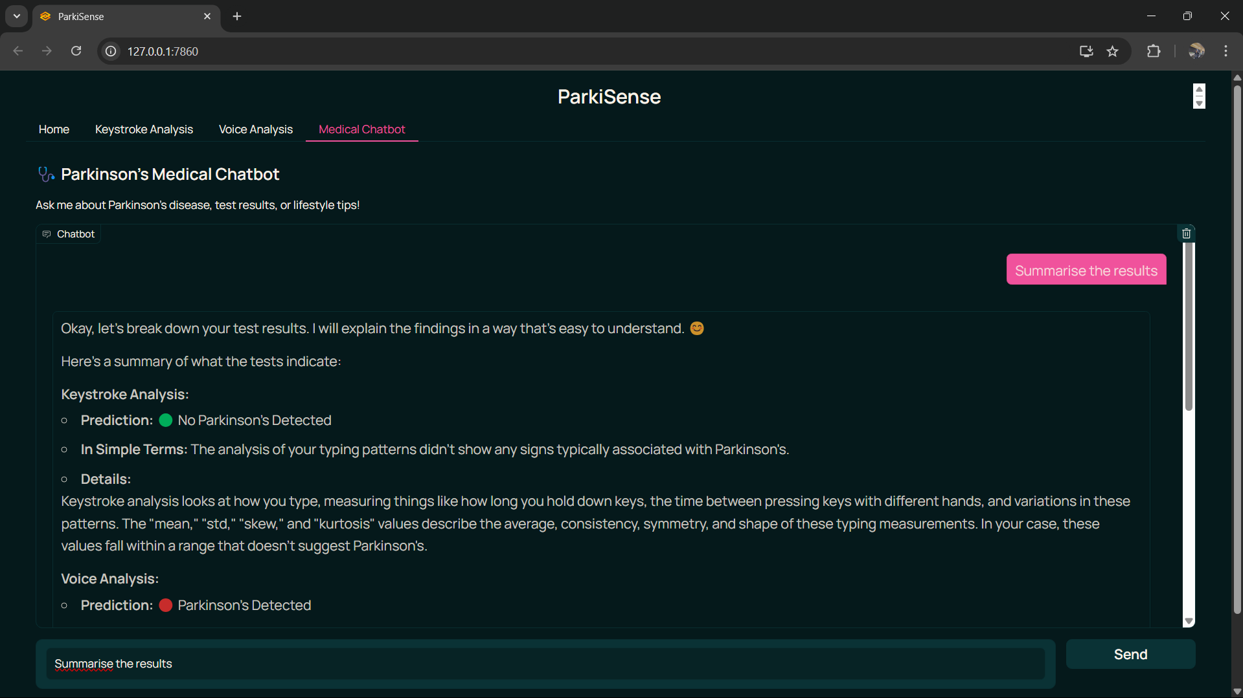
Demo and Application

Slide 16

Conclusion and Future Work
Timely Medical Interventions
Medication Adjustments: Doctors can prescribe medications earlier to slow disease progression (e.g., Levodopa for Parkinson’s).
Physical Therapy: Improves mobility, coordination, and strength.
Minimally Invasive Treatments: Early detection allows for less aggressive treatments with fewer side effects.
Regular Monitoring
Frequent doctor consultations to adjust treatments.
Wearable devices to track symptoms (e.g., tremors, movement).
AI-powered diagnostics for continuous health assessment.

Slide 17
Conclusion and Future Work
Key Takeaways:
SGD is an effective approach for Parkinson’s prediction.
Tappy data provides valuable insights into motor function decline.
Future Improvements:
Explore deep learning models for improved accuracy.
Incorporate additional biomarkers for enhanced prediction.
Deploy the model for real-world use in early diagnosis.

Slide 18

THANK YOU !
Made By:-
Ayush Pandita - J013
Prithvi Singh - J046
Suchir Thaokar - J065

